Slide 1

THE BEHAVIOR OF 6G SYSTEM FOR DIFFERENT BANDWIDTHS
ROLL NO: | 21030121 | HITIK KUMAR NAYAK
ROLL NO: | 21030122 | JAKKULA RAJESH
ROLL NO: | 21030143 | PRITESH KUMAR
UNDER THE GUIDANCE OF
DR. PANKAJ SHANKAR SHRIVASTAVA
(ASSOCIATE PROFESSOR)

Slide 2
CONTENTS
Abstract
Introduction
Literature Survey
Theory
5G vs 6G
Shannon Hartley’s Channel Capacity
Sub-Tera Hertz System
Spectral efficiency for Different BW
Analysis & Results
Conclusion
Reference

Slide 3
ABSRTACT
It is a 6G technology that is proposed to be upgraded to 5G technology. It is expected to integrate 5G with satellite networks for global coverage. 6G technology is considered to be cheap and fast, providing high data rates and fast Internet speed to access on air through wireless and mobile devices with data ranges up to 11 Gbps. This report examines the relationship between spectral efficiency and Signal to Interference plus Noise Ratio (SINR) in the context of sub-Tera Hertz system.

Slide 4

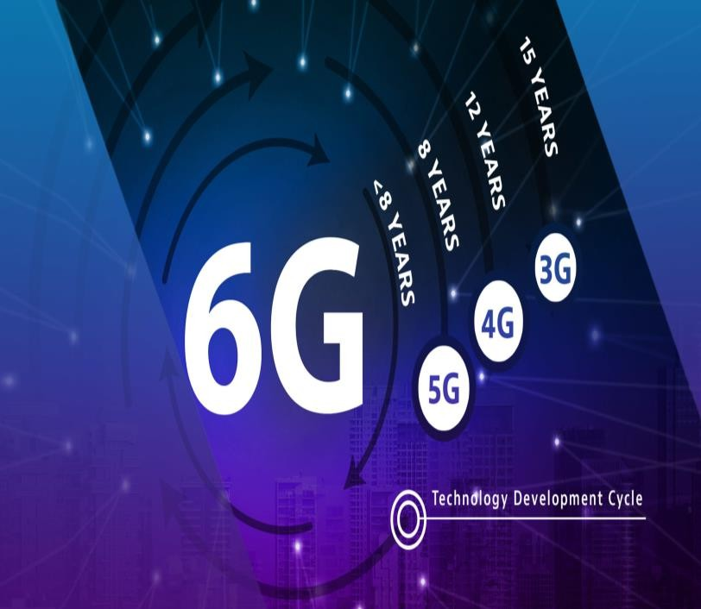
INTRODUCTION
Evolution of Wireless Technologies
Wireless communication has come a long way from 1G to 5G, with each generation introducing significant advancements in speed, connectivity, and application capabilities
Ex: Wireless symbol with progressive arrows
The Need for Faster, More Reliable Networks
With the exponential rise in data traffic, IoT devices, and AI integration, the need for and more dependable networks is pushing the demand for 6G
Ex: Speedometer with high-speed mark
What is 6G?
6G is the next major leap in wireless communication, promising faster speeds,
lower latency, and global connectivity. It will unlock new possibilities for both individuals and industries.
Ex: Satellite network globe
6G Beyond Mobile Connectivity
While 5G focuses on mobile broadband, 6G aims to extend connectivity
communication.
Ex: Holographic projection
Global Coverage with Satellite Integration
to autonomous systems, smart cities, and holographic
Unlike 5G, which depends on terrestrial infrastructure, 6G integrates satellite networks for seamless global coverage, ensuring connectivity in even the most remote regions.
Ex: Satellite orbiting Earth

Slide 5


Literature Survey
Ref . No | Title of the Pages | Findings
1 | "6G Wireless Networks:Vision, Requirements, and Key Technologies" | 50-100 GHz enables high data rates, but signal loss and line-of-sight limitations impact range. Power, antenna gains, and interference management are crucial for performance.
2 | "Terahertz Communication for 6G Networks" | 150-200 GHz offers ultra-high speeds but suffers from high signal loss and short range. Dense infrastructure is needed to overcome these challenges.
3 | "Opportunities and Challenges of Sub-THz Communication in 6G" | 100-150 GHz provides high throughput for IoT but faces challenges with interference and path loss. Optimizing gains and minimizing noise is essential for efficiency.
4 | "Millimeter-Wave and Sub-Terahertz Band for 6G: Spectrum and Propagation Characteristics" | 50-100 GHz offers high-speed communication but is affected by high attenuation, requiring careful management of noise and interference.
5 | "Channel Modeling and Propagation for Terahertz Communication in 6G" | 150-200 GHz supports terabit-per-second speeds but is limited by severe path loss, requiring advanced antenna designs and power control.

Slide 6
Ref . No | Title of the Pages | Findings
6 | "Towards 6G:The Role of the 10-20 MHz Frequency Band in Low-Power IoT Applications" | 10-20 MHz is ideal for long-range, low-power IoT communication with minimal signal loss, but provides lower data speeds.
7 | "The Impact of Frequency Bands on 6G System Design" | Higher frequencies like 100-150 GHz offer fast speeds but suffer from high interference and path loss. Lower frequencies like 10-20 MHz offer better coverage at slower speeds.
8 | "Challenges and Opportunities of 6G Wireless Communications: A Survey" | 100-150 GHz is suitable for smart cities, but interference and noise must be minimized for optimal performance.
9 | "Advanced Antennas and Propagation for Terahertz Wireless Systems" | 150-200 GHz offers high speeds but requires advanced antenna designs to overcome severe signal attenuation and short-range limitations.
10 | "Low-Power Communication in 6G: The Role of the 10-20 MHz Band" | 10-20 MHz is ideal for long-range IoT communication with minimal signal loss, although it offers slower speeds compared to higher frequencies.

Slide 7
Theory
50 GHz to 100 GHz Band:
Benefits: Offers fast data rates and low latency.
Applications: Great for VR, AR, and URLLC (Ultra-Reliable Low-Latency Communication).
Challenges: Shorter range due to higher signal loss and need for line of sight.
100 GHz to 150 GHz Band:
Benefits: Provides even faster data speeds.
Applications: Ideal for smart cities and advanced IoT.
Challenges: Best for short-range, high-capacity uses, with higher signal loss and weather sensitivity.
150 GHz to 200 GHz Band:
Benefits: Can achieve data speeds in terabits per second.
Applications: Perfect for high-precision technologies like AI and holography, and huge data transfers.
Challenges: Requires expensive infrastructure and has very short range due to high signal loss.
10 MHz to 20 MHz Band:
Benefits: Provides wide coverage and less signal loss.
Applications: Suitable for long-range communication and IoT devices.
Challenges: Slower speeds and limited bandwidth due to current use in mobile networks.
Summary:
Lower frequencies: Better for coverage but slower speeds.
Higher frequencies: Offer faster speeds but shorter range.

Slide 8

Table-1: 5G vs 6G
Aspect | 5G | 6G
Generation | Fifth Generation (5G) | Sixth Generation (6G)
When it Arrived | Started rolling out in 2019-2020 | Expected around 2030
Speed | Super fast, up to 10 Gbps | Superfast fast, up to 1 Tbps
Delay (Latency) | Very low, ~ 1ms | Even lower(~0.1 ms)
Frequency | Approx 24–100 GHz | Approx 100 GHz–10 THz
Bandwidth | Moderate (up to 400 MHz) | Huge, several times broader than 5G
Devices Connected | Handles 1 million devices per square Km | Connect 10 million devices in same area
Energy Use | Energy-efficient compared to 4G | Even greater energy efficiency with AI
Main Uses | Smart cities, IoT, automation | Holograms, AR/VR, space networks
Cool Tech Behind It | Massive MIMO, Beamforming, Network Slicing | Powered by AI, quantum communication
Security | Safer than older systems | Ultra-secure with quantum-proof encryption

Slide 9

Shannon Hartley’s Channel Capacity
Enhanced Capacity Metrics :
From Shannon Hartley’s Theorem, channel capacity C may be given as:
C=
𝐥𝐨𝐠
(𝟏 𝑺𝑵𝑹) ……………………………………[1]
𝐁
∗
𝟐
+
Where B: Bandwidth of communication channel SNR: Signal to Noise Ratio

Slide 10



SUB-TERA HERTZ SYSTEM
(Freq Range= 100 to 300 GHz)
The SINR of the this 6G system is defined as:
_{S(y)=}PAGAGUSFUF
(N0W+I)L(y)
and Spectral efficiency R = log2[1+s(y) ]
……………………………………[2]
Where,
S(y): SINR for user y
PA: Transmitted Power
GA: Antenna Gain at Base Station
GU: Antenna Gain at user end
SF: Shadow fading
UF: User fraction
N0: Noise power spectral density
W: Bandwidth of the channel
I: Interference
L(y): Channel loss

Slide 11
SPECTRAL EFFICIENCY FOR DIFFERENT BANDWIDTHS
Figure:1

Slide 12
Fig. 1:The Figure shows the for constant Scaling Factors and constant User Fraction, if we increases Band Width then Spectral efficiency decreases, here lower ring have highest BW i.e. 20MHz but spectral efficiency is less as compared to that of 10MHz.
On the other hand, for constant Band Width & constant User Fraction, if we increase the Scaling Factors the Spectral Efficiency (R) increases, here yellow line has more Spectral Efficiency(R).

Slide 13
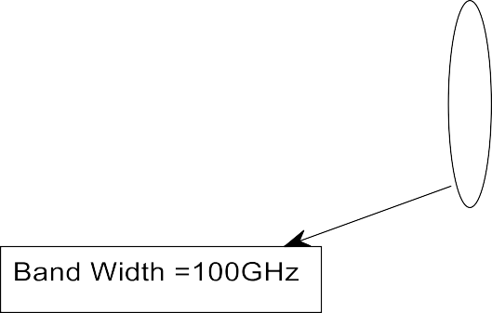


Slide 14
Fig. 2:The Figure shows the for constant Scaling Factors and constant User Fraction, if we increases Band Width then Spectral efficiency decreases, here lower ring have highest BW i.e. 100GHz but spectral efficiency is less as compared to that of 50GHz.
On the other hand, for constant Band Width & constant User Fraction, if we increase the Scaling Factors the Spectral Efficiency (R) increases, here yellow line has more Spectral Efficiency(R).

Slide 15
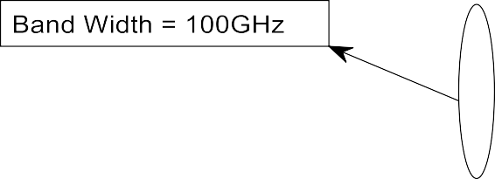


Slide 16
Fig. 3:The Figure shows the for constant Scaling Factors and constant User Fraction, if we increases Band Width then Spectral efficiency decreases, here lower ring have highest BW i.e. 150GHz but spectral efficiency is less as compared to that of 100GHz.
On the other hand, for constant Band Width & constant User Fraction, if we increase the Scaling Factors the Spectral Efficiency (R) increases, here yellow line has more Spectral Efficiency(R).

Slide 17
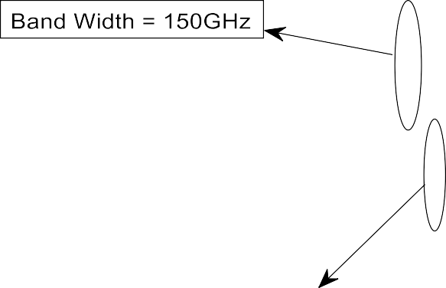


Slide 18
Fig. 4:The Figure shows the for constant Scaling Factors and constant User Fraction, if we increases Band Width then Spectral efficiency decreases, here lower ring have highest BW i.e. 200GHz but spectral efficiency is less as compared to that of 150GHz.
On the other hand, for constant Band Width & constant User Fraction, if we increase the Scaling Factors the Spectral Efficiency (R) increases, here yellow line has more Spectral Efficiency(R).

Slide 19
ANALYSIS & RESULTS:
System Parameters :
For Band Widths 10MHz, 20MHz,
Scaling Factors are 0.20 (blue line) , 0.22 (red line) & 0.24 (yellow line)
For Band Widths 50GHz, 100GHz,
Scaling Factors are 0.5 (blue line) , 0.7 (red line) & 0.8 (yellow line)
For Band Widths 100GHz, 150GHz,
Scaling Factors are 0.50 (blue line) , 0.55 (red line) & 0.60 (yellow line)
For Band Widths 150GHz, 200GHz,
Scaling Factors are 0.10 (blue line) , 0.12 (red line) & 0.13 (yellow line)

Slide 20
DISSCUSSION
Impact of Scaling factor on Spectral Efficiency
Scaling factors directly affect spectral efficiency (bits per second per Hz). Higher scaling factors allow more information to be transmitted within a given bandwidth.
𝑆𝑐𝑎𝑙𝑖𝑛𝑔 𝐹𝑎𝑐𝑡𝑜𝑟 ↑ ⇒ 𝑅 ↑ (constant UF, constant BW)
According to the figure (graphs)
Fig. 1: Bandwidths = 10 MHz and 20 MHz
Curves are plotted for scaling factors of 0.20, 0.22, and 0.24.
At UF=0.5, the yellow curve (0.24) achieves the highest spectral efficiency.
Similarly, we can say for remaining three fig.
Impact of Band Width on Spectral Efficiency
𝑩𝑾 ↑ ⇒ 𝑹 ↓
(constant UF, constant Scaling Factor)
Two bandwidths are considered: 10 MHz and 20 MHz (Fig. 1)
The spectral efficiency decreases as bandwidth increases.
For example: At UF=0.5, the 20 MHz curves are bellow the 10 MHz curves for all scaling factors

Slide 21
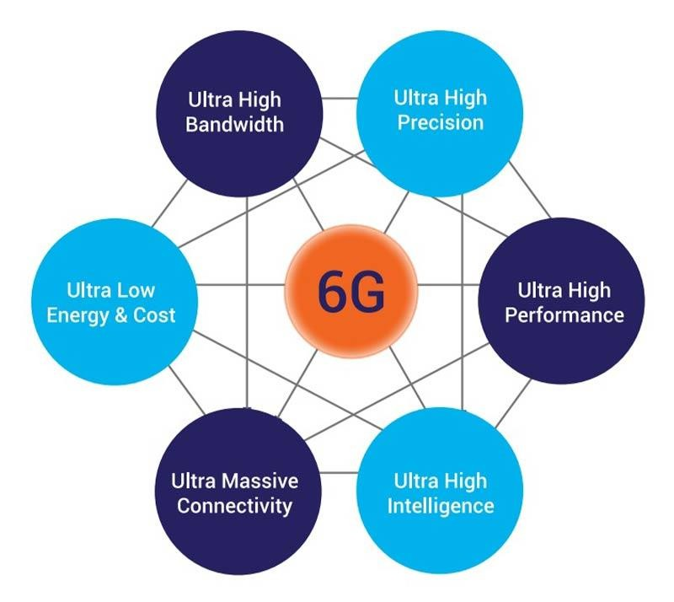
6G System Model for Different Bandwidths
Frequency Bands:
GHz (50-200 GHz): Fast, short-range communication for urban areas.
MHz (10-20 MHz): Long-range, dependable communication for rural
areas.
Scaling Factor: Adjusts performance based on power, range, and signal travel; higher for GHz, lower for MHz .
User Fraction: GHz for dense areas, MHz for narrow areas.
Spectral Efficiency: GHz offers high data efficiency, MHz is simpler with lower efficiency.
MATLAB Simulation: Models how bandwidth, user distribution, and
efficiency interact in different scenarios.
The image highlights the key features of 6G system ultra-high bandwidth, precision, performance, energy efficiency, massive connectivity, and intelligence. These characteristics aim to revolutionize wireless communication and enable a future with faster, more reliable, and intelligent networks.

Slide 22
CONCLUSION
In the final analysis, the MATLAB-plotted graphs for bandwidths ranging from 50-100 GHz, 100-150 GHz, 150-200 GHz, and 10-20 MHz prove how the 6G system behaves differently across various frequency bands. For constant User Fraction & constant Band Width, high Scaling Factor shows high Spectral Efficiency, but in other hand for constant User Fraction & constant Scaling Factor, high Band Width shows high Spectral Efficiency. So, for high Spectral efficiency shows high data rate. Sub-THz systems operate in the frequency range of 100-300GHz. 6G will make a revolution with ultra-fast speeds, sub-THz frequencies, AI driven intelligent networks, AR/VR, holography.

Slide 23
REFERENCE
Mostafa Z. Chowdhury, Md. Shahjalal, Shakil Ahmed, Yeong Min Jang “6G Wireless Communication Systems: Applications, Requirements, Technologies, Challenges, and Research Directions”
DOI: 10.1109/OJCOMS.2020.3010270
Models, Methods, and Solutions for Multicasting in 5G/6G mm-Wave and Sub-THz Systems Nadezhda Chukhn
Osel Lhamo, Tung V. Doan, Giang T. Nguyen, Frenk H.P. Fitzek “Adaptive Network Coding: Achieving a Reliability-Latency Tradeoff for 5G and 6G Systems”
DOI: 10.1109/NFV-SDN59219.2023.10329621
Sabuj Sarkar, Saikat Adhikari, Md. Mostfizur Rahman “On achieving optimal channel capacity of MIMO- PSK systems over Rayleigh fading channel”
DOI: 10.1109/DEVIC.2017.8074028
Feng Man, Wu Lenan “Extension to Shannon’s channel capacity —the theoretical proof”
DOI: 10.1109/ICICS.2007.4449550
Andriy Luntovskyy, Igor Melnyk, Alina Pochynok “5G and Beyond: Shannon's Channel Capacity”
DOI: 10.1109/IDT59031.2023.10194455
Nadezhda Chukhno, Olga Chukhno, “Models, Methods, and Solutions for Multicasting in 5G/6G mmWave and Sub-THz Systems”
DOI: 10.1109/COMST.2023.3319354

Slide 24



